Slide 1

Semi-conductor defect images classification
HUANG, Hanli

Slide 2
Contents
Introduction
Data
Methodology
Results
Conclusion

Slide 3
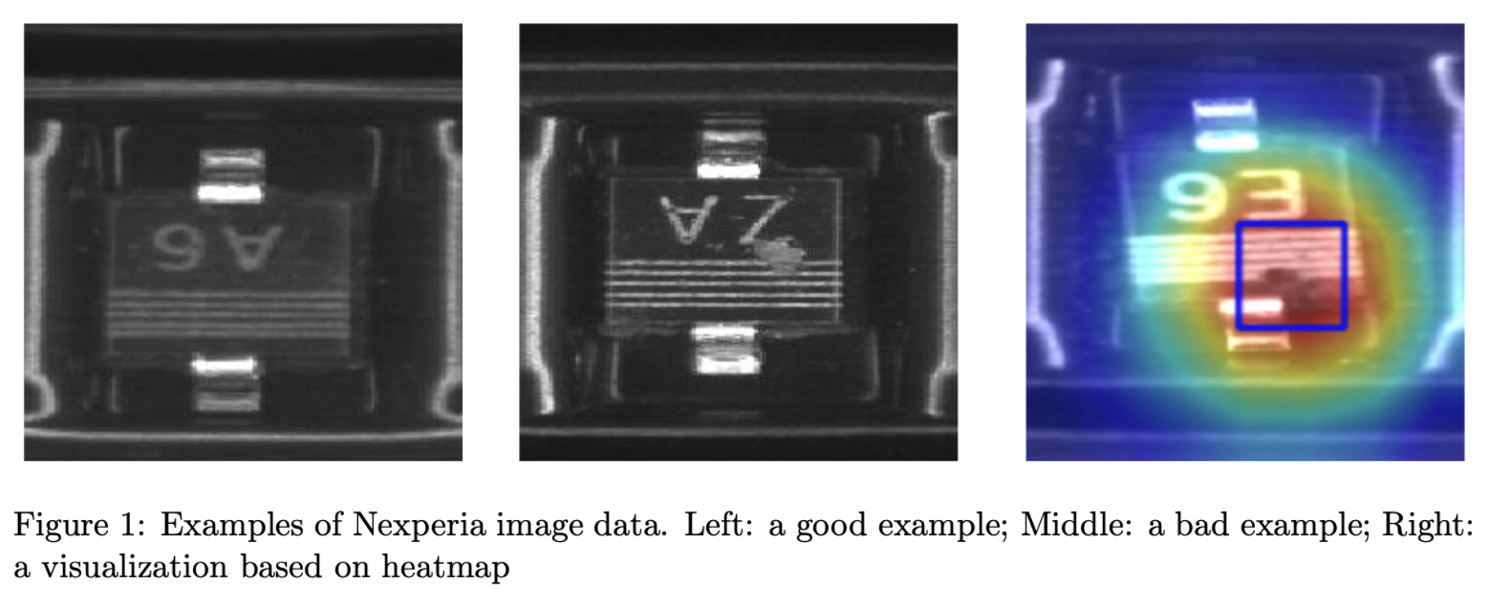
Introduction

Slide 4
Data
34457 images
27420 Good
7039 Defect
Kaggle test
3830 Images
Training
24121 Images
Test
6892 Images
Validation
3444 Images
Model Training
Hyper-parameter fine-tune and
Final validation

Slide 5
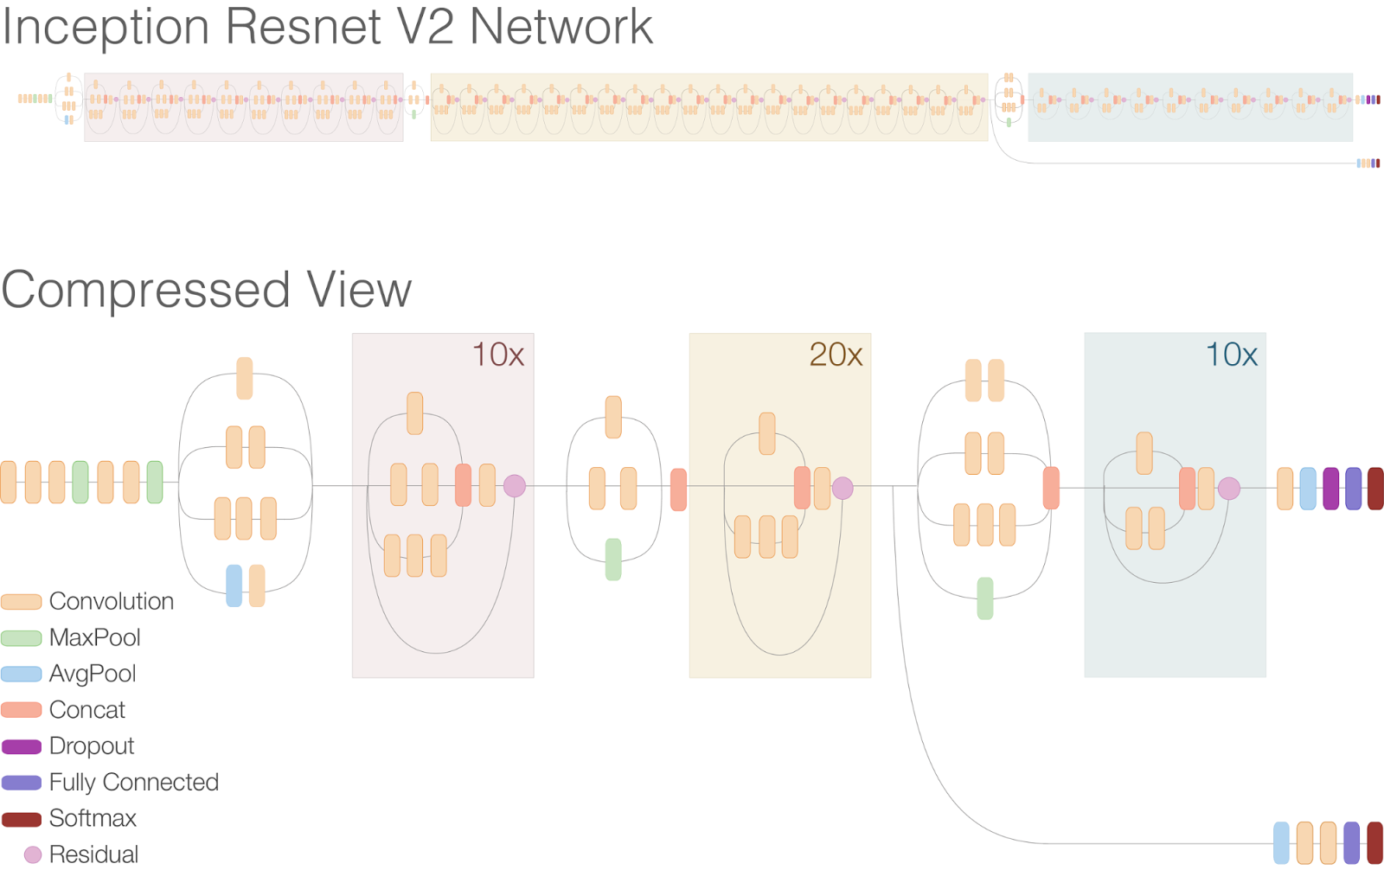
Model

Slide 6
Training
Data augmentation：
Randomly rotation
Randomly shifting
Randomly shearing
Randomly flipping
Weight adjust：
Defect/Good ： 10/1

Slide 7
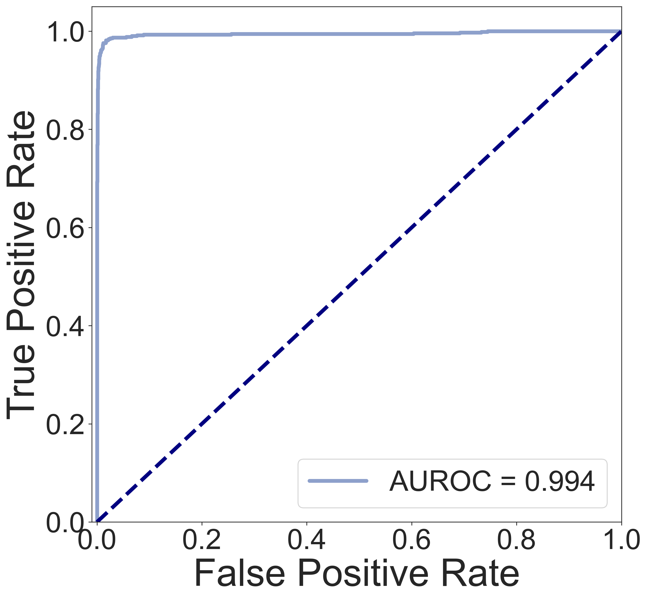
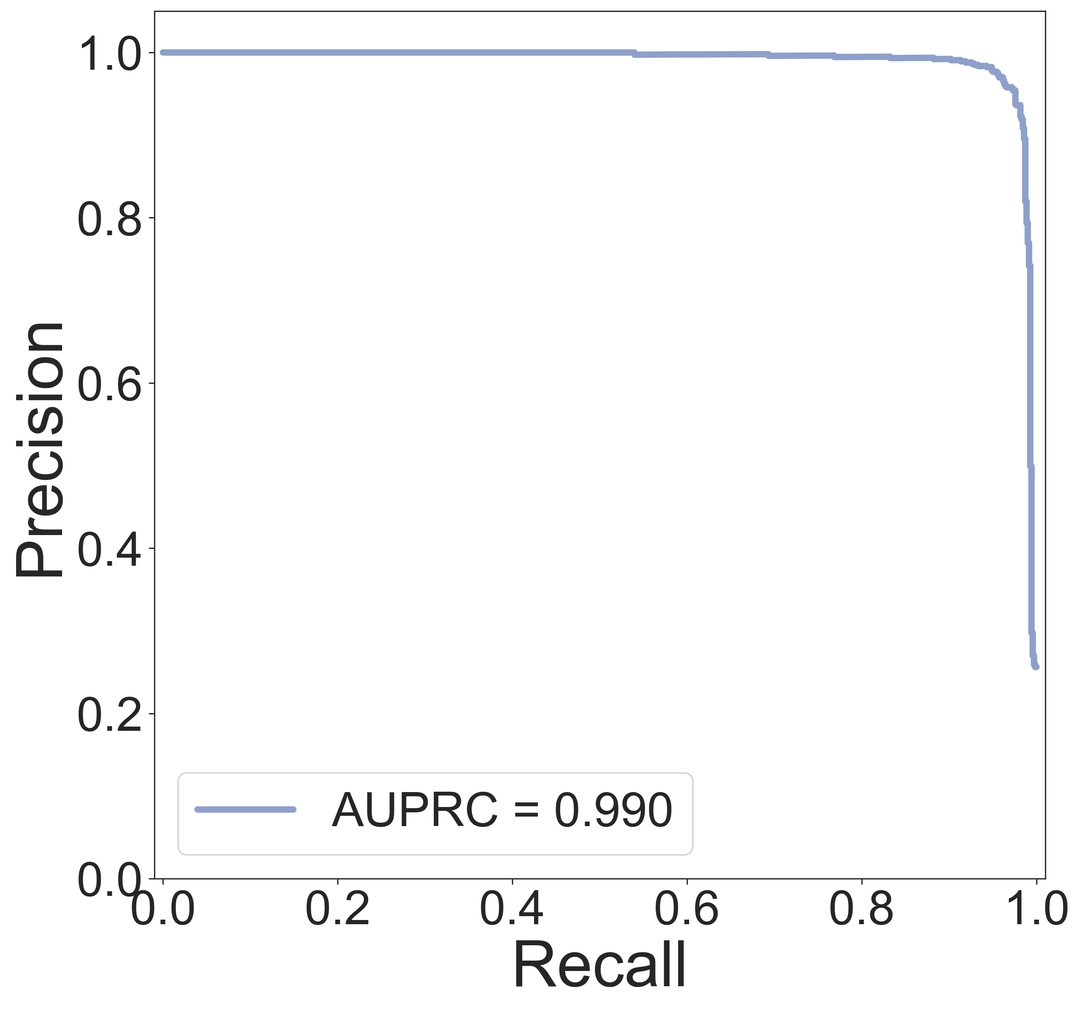
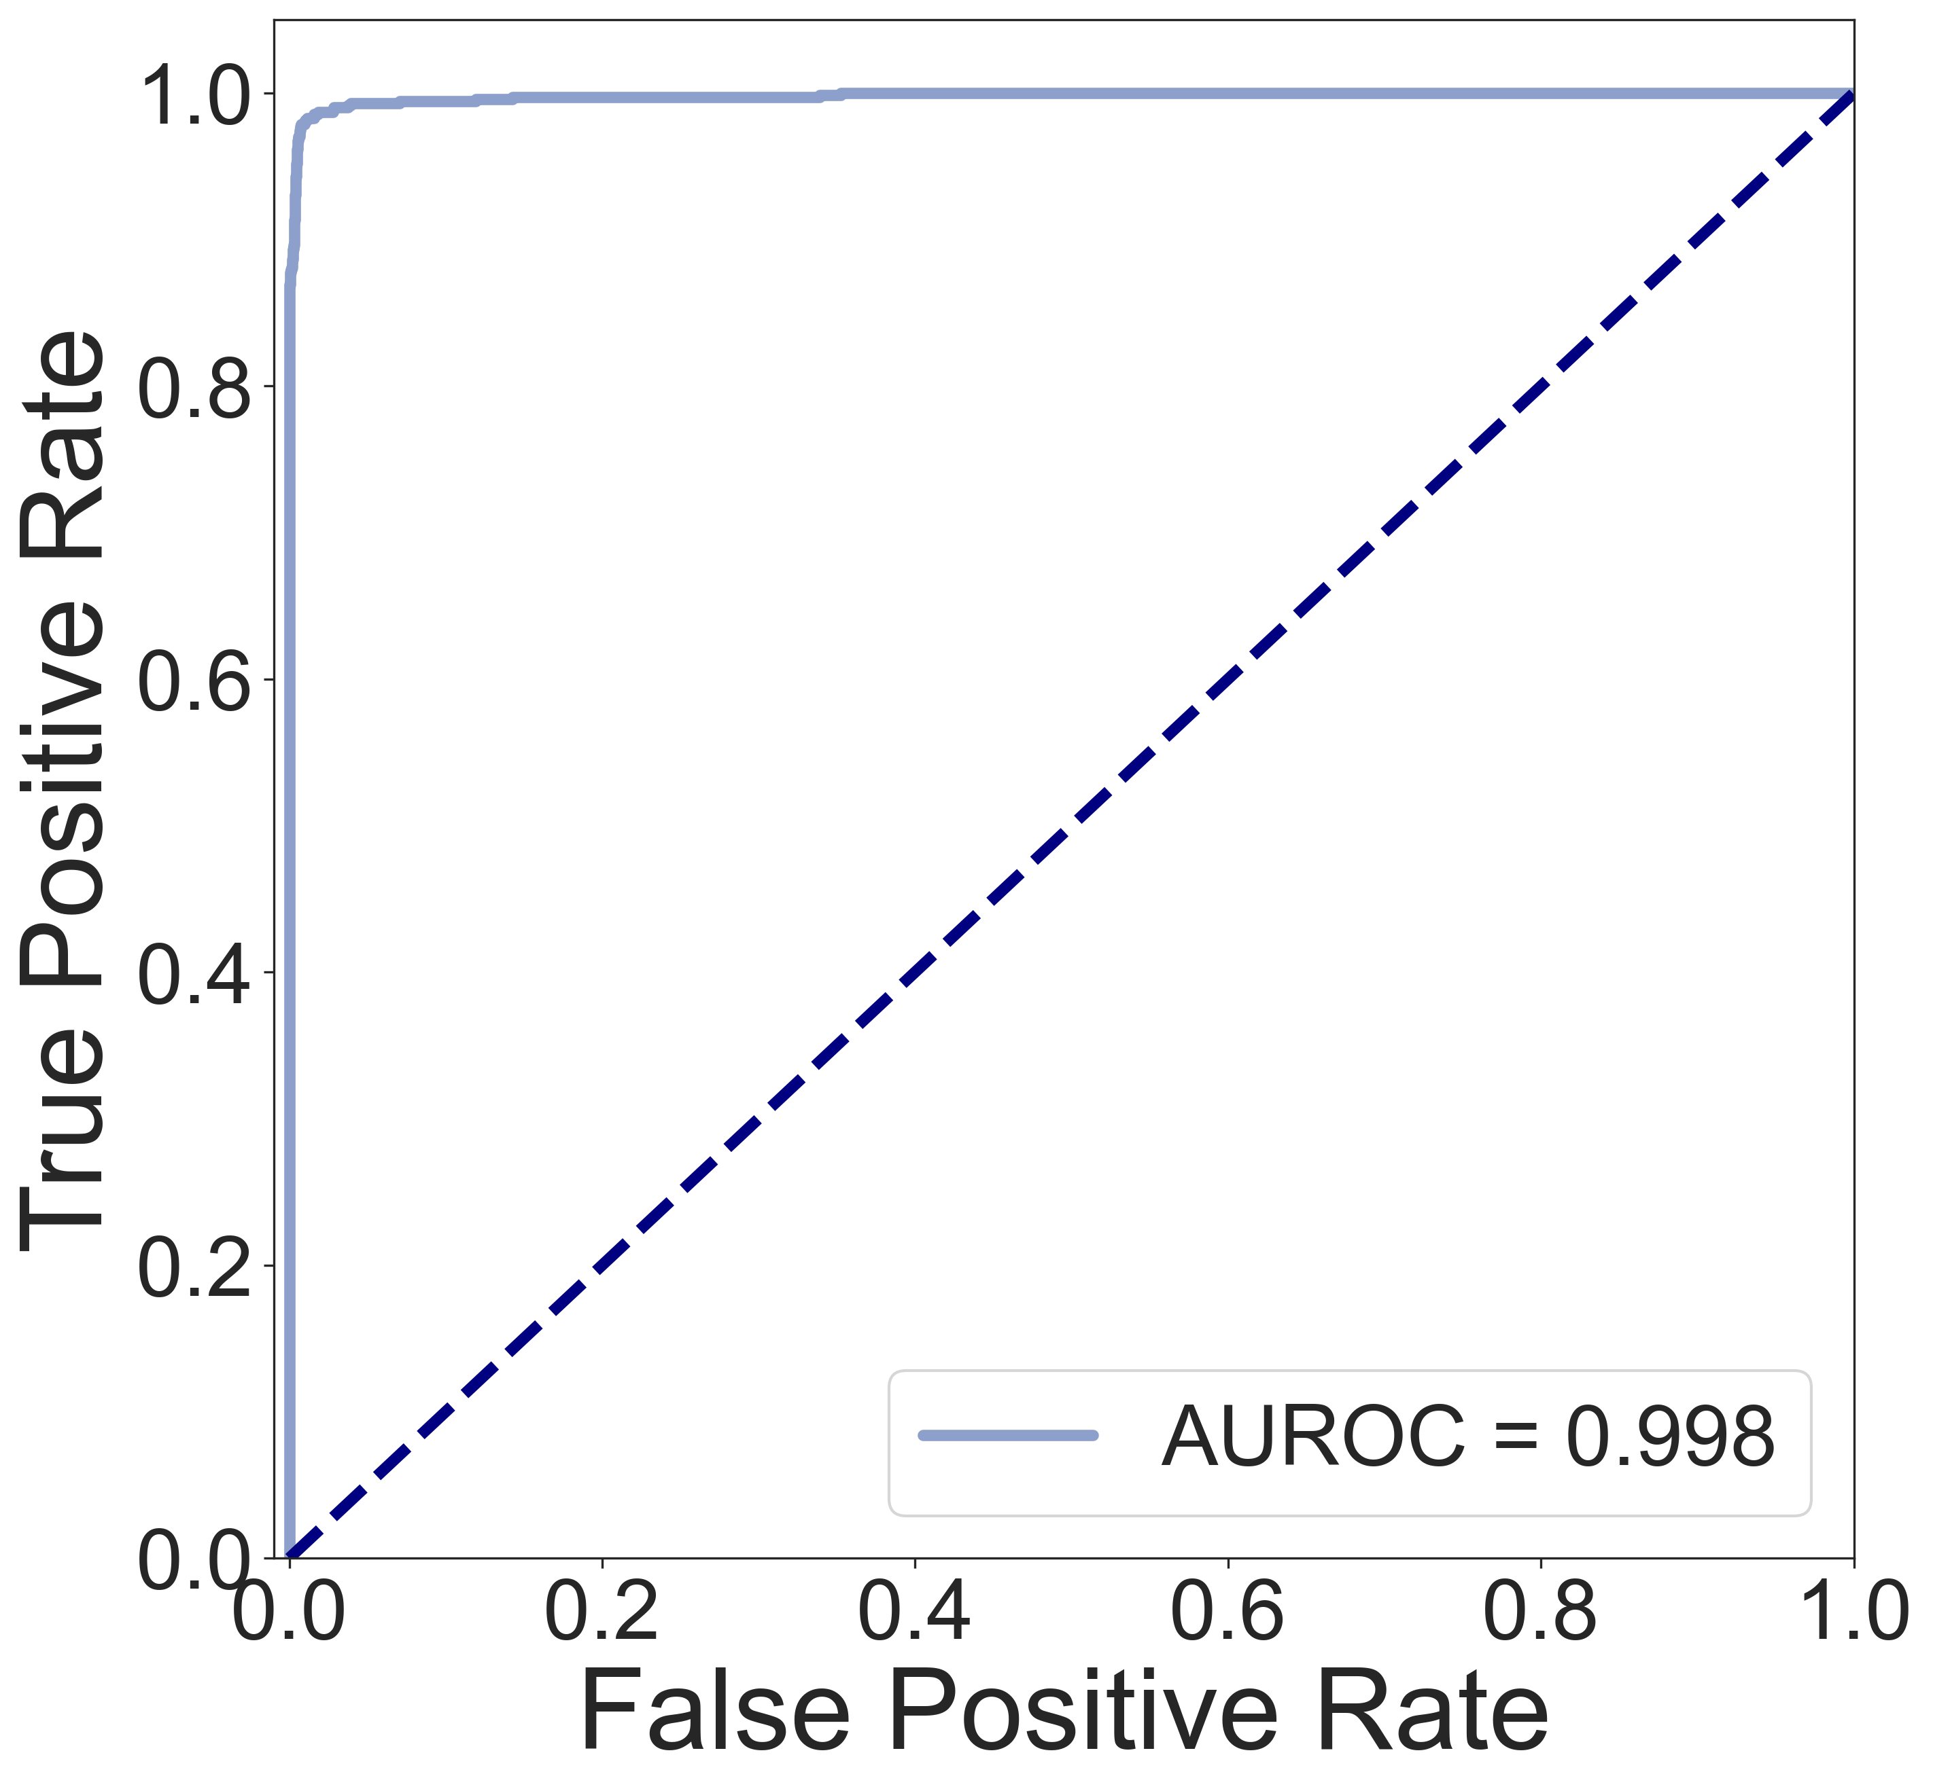
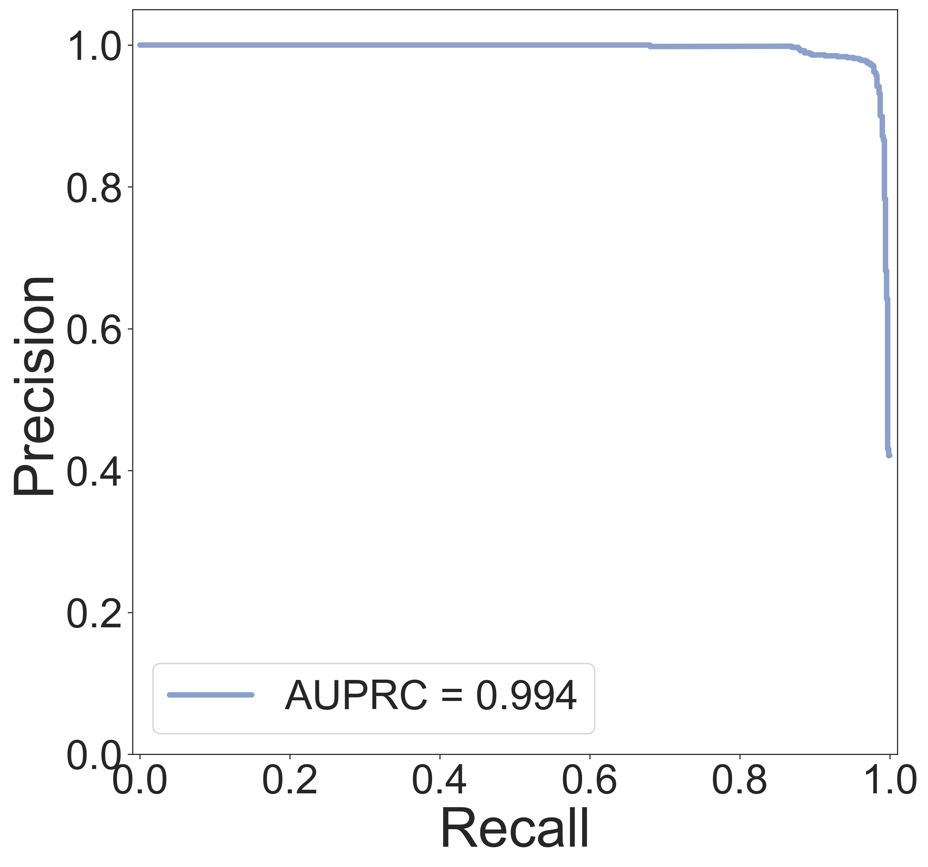
Result
Basic
Weight adjust

Slide 8
FPR comparison under different TPR
 | FPR (Basic) | FPR (Weight adjust)
TPR>0.9 | 0.18% | 0.33%
TPR>0.95 | 0.55% | 0.44%
TPR>0.99 | 6.6% | 2.8%

Slide 9
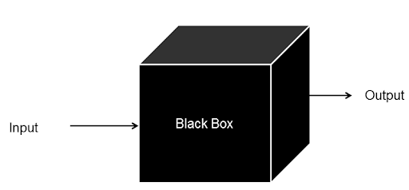
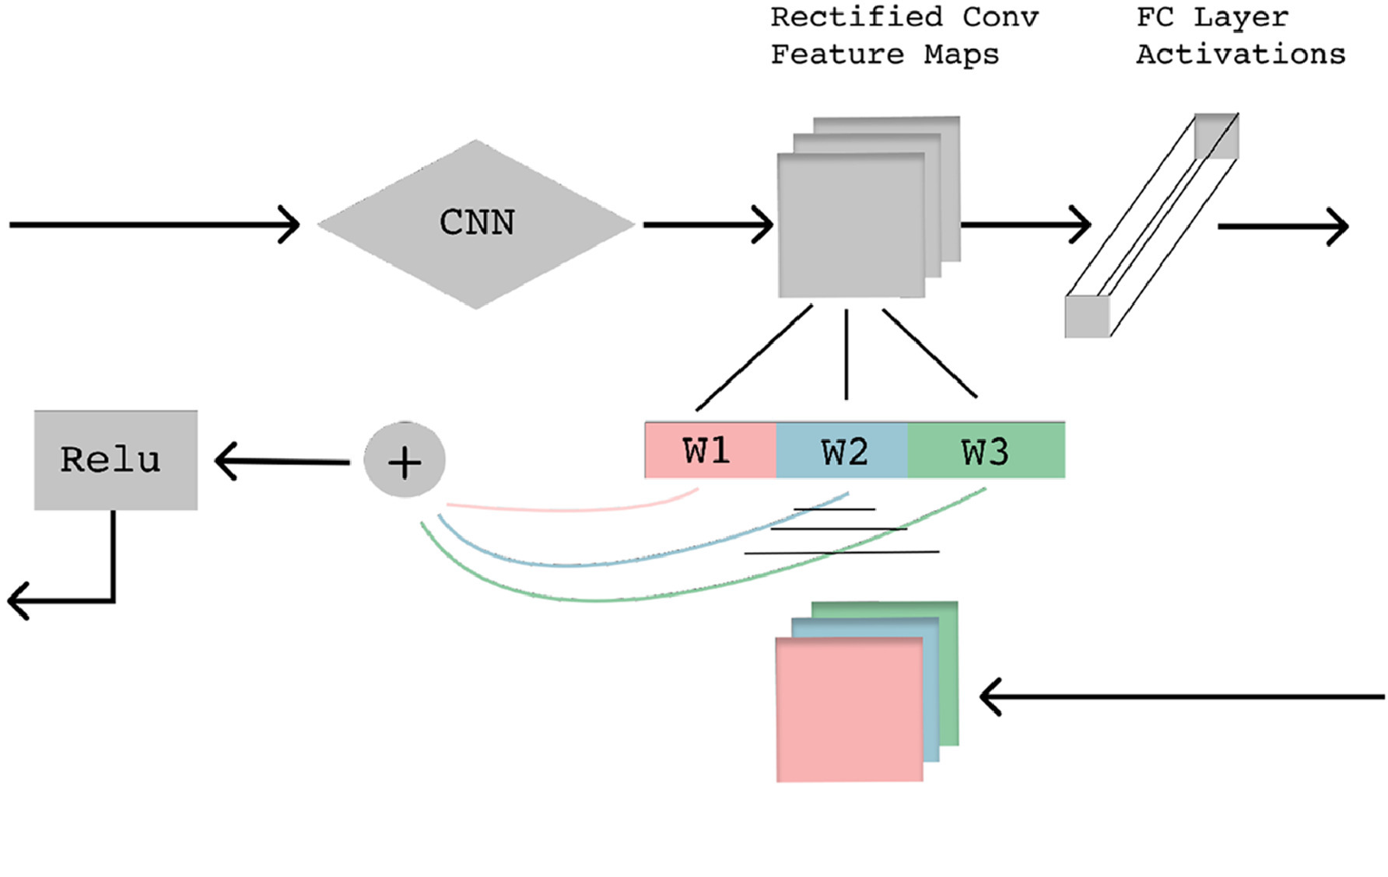
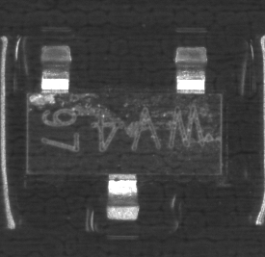

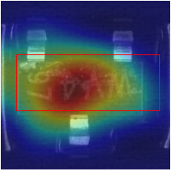
Explanation of models
Defect
Good

Slide 10
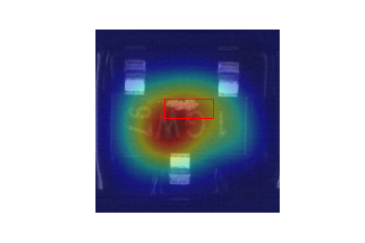
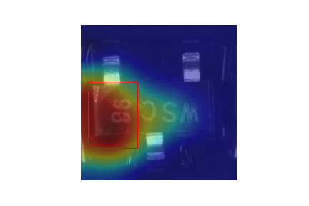
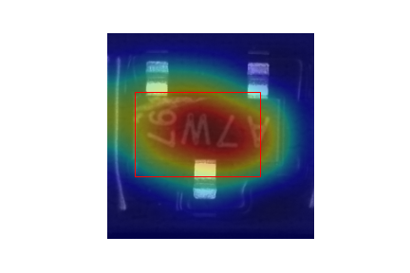
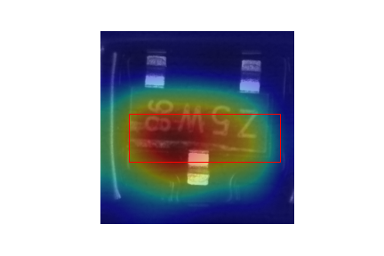
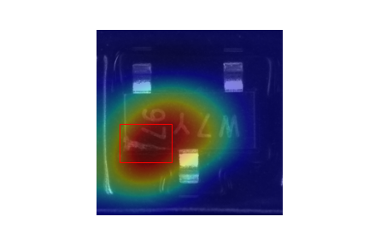
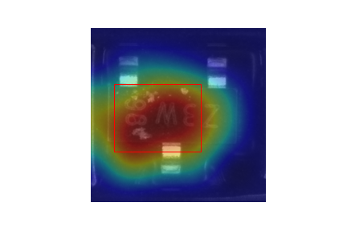

Slide 11
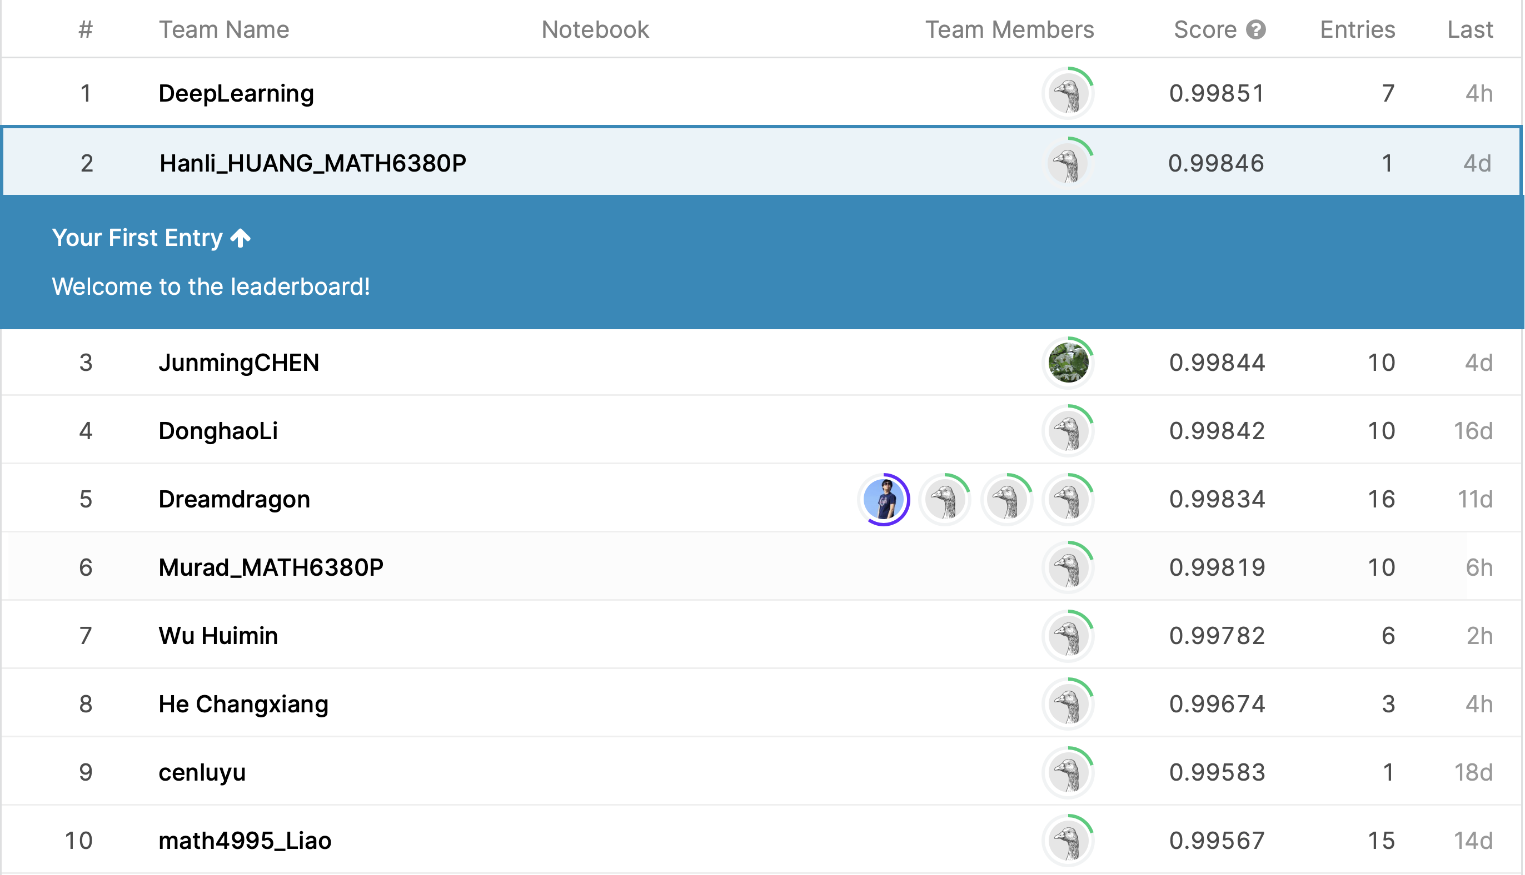
Result on the Kaggle test

Slide 12
Conclusion and discussion
Basic model worked quite well
Weight adjust improved the performance
Grad-CAM explained the prediction
About the batch effect
Main difference between batches
Color or gray scale normalization
Add noise or do random brightness or Contrast adjust

Slide 13
Thanks!

